Slide 1
ANALYSIS PREDICTIONS OF SPREAD, RECOVERY AND DEATH CAUSED BY COVID-19 IN INDIA
Presented By: Nikesh Kumar
MT/IT/10011/20
Under the supervision of: Dr. Subrajeet Mohapatra
Assistant Professor

Slide 2
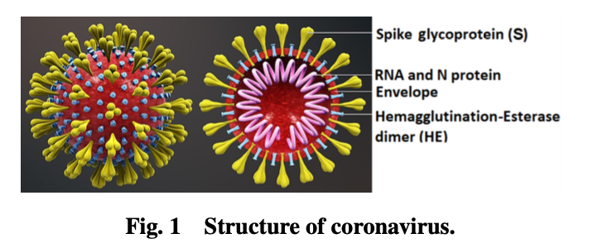
INTRODUCTION
Coronavirus virus (CoV) is a special type of virus that is a disease in itself and that aggravates the existing disease in the human body, making it a very dangerous virus.
COVID-19 first case became mentioned in Huanan Seafood Wholesale Market, Wuhan.
This virus transmitted from animal-to-human.
In India, the first case of Coronavirus Disease 2019 (COVID19) was reported on January 30, 2020, which spread to all of India (in its various districts) by the end of April 2020.
Symptoms: Fever , Cough, Shortness of breath or difficulty breathing, Fatigue, Muscle or body aches, Headache, loss of taste or smell, Sore throat, Congestion or runny nose.
Treatment and prevention:Wear a mask, Use hand sanitizer, social distancing and vaccination.

Slide 3
OBJECTIVES
Prediction of discharge ratio using linear regression.
To observe the correlation between active cases and discharge.
Visualization of other variables.

Slide 4
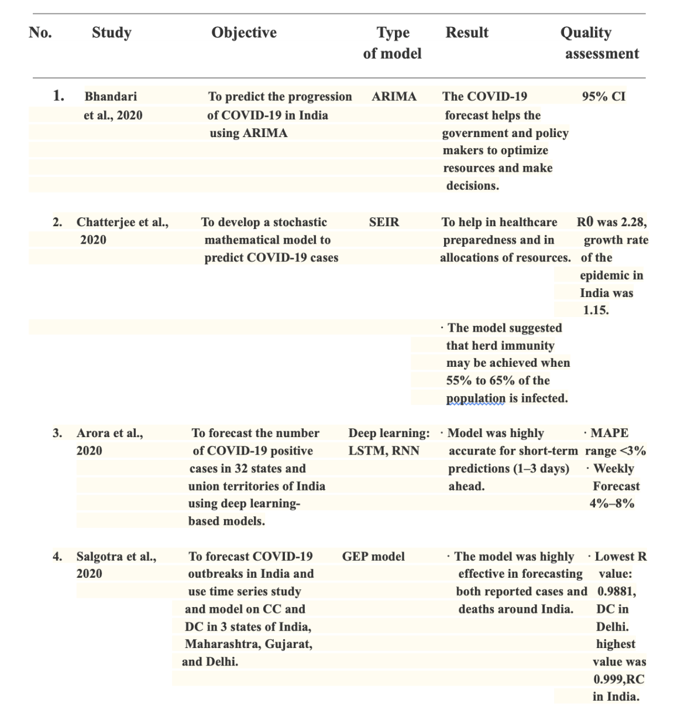
Literature Review
There are some most inspiring related works in the field of this Covid-19 prediction.

Slide 5
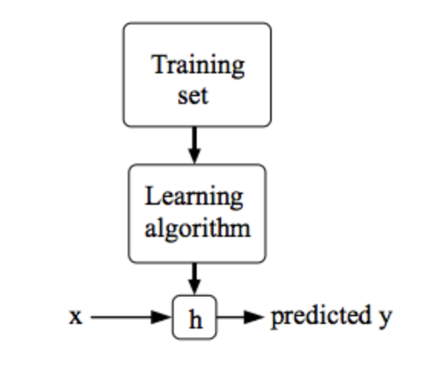
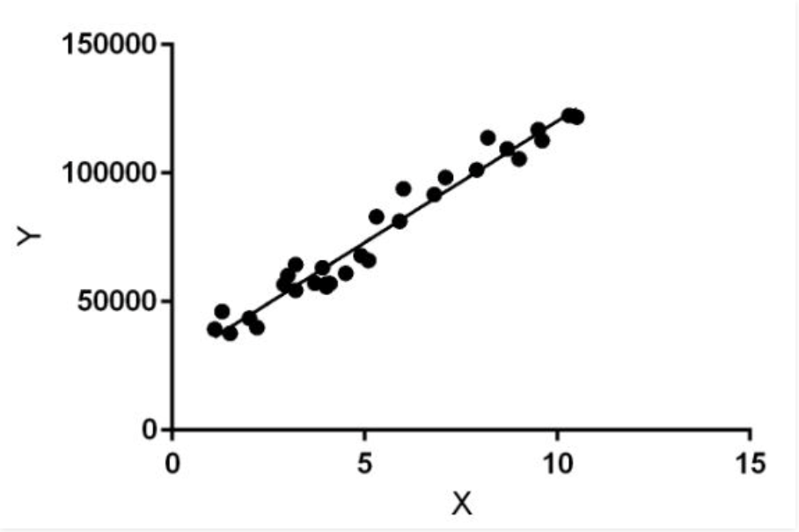
Overview of model used​
Linear Regression
Linear Regression is a machine learning algorithm based on supervised learning.
Regression models target prediction value based on independent variables.
It is mostly used for finding out the relationship between variables and forecasting.
In the figure above, X (input) is the work experience and Y (output) is the salary of a person. The regression line is the best fit line for our model.

Slide 6
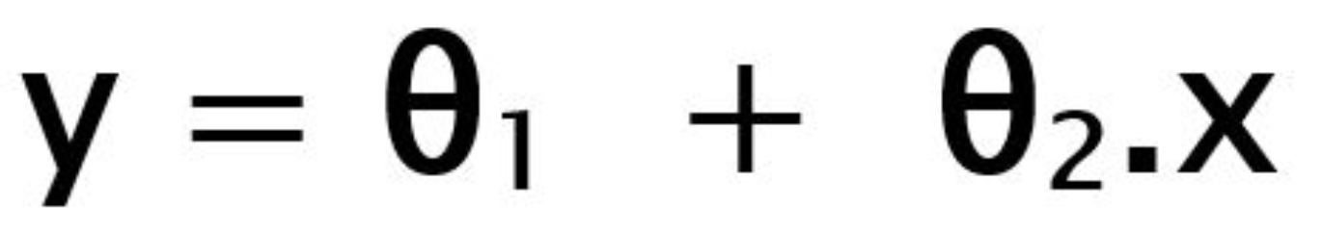
Hypothesis function for Linear Regression :
While training the model we are given :
x: input training data (univariate – one input variable(parameter))
y: labels to data (supervised learning)
When training the model – it fits the best line to predict the value of y for a given value of x. The model gets the best regression fit line by finding the best θ1 and θ2 values.
θ1: intercept
θ2: coefficient of x
Once we find the best θ1 and θ2 values, we get the best fit line. So when we are finally using our model for prediction, it will predict the value of y for the input value of x.

Slide 7
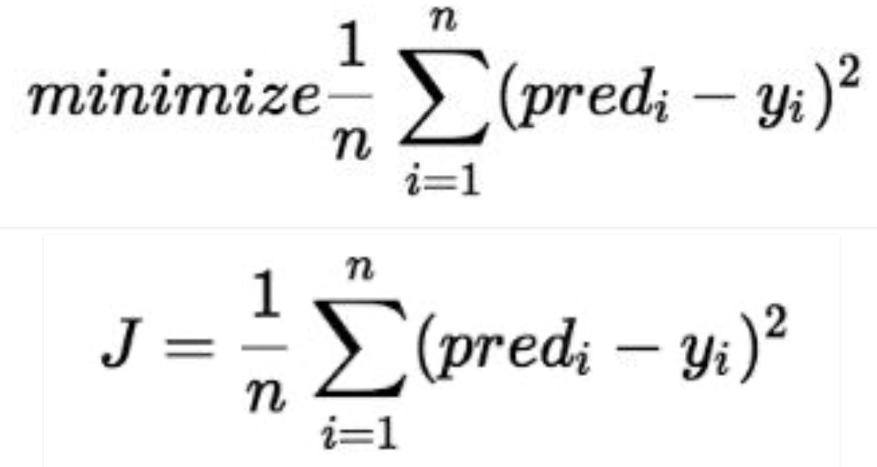
Cost Function (J):
Cost function(J) of Linear Regression is the Root Mean Squared Error (RMSE) between predicted y value (pred) and true y value (y).

Slide 8
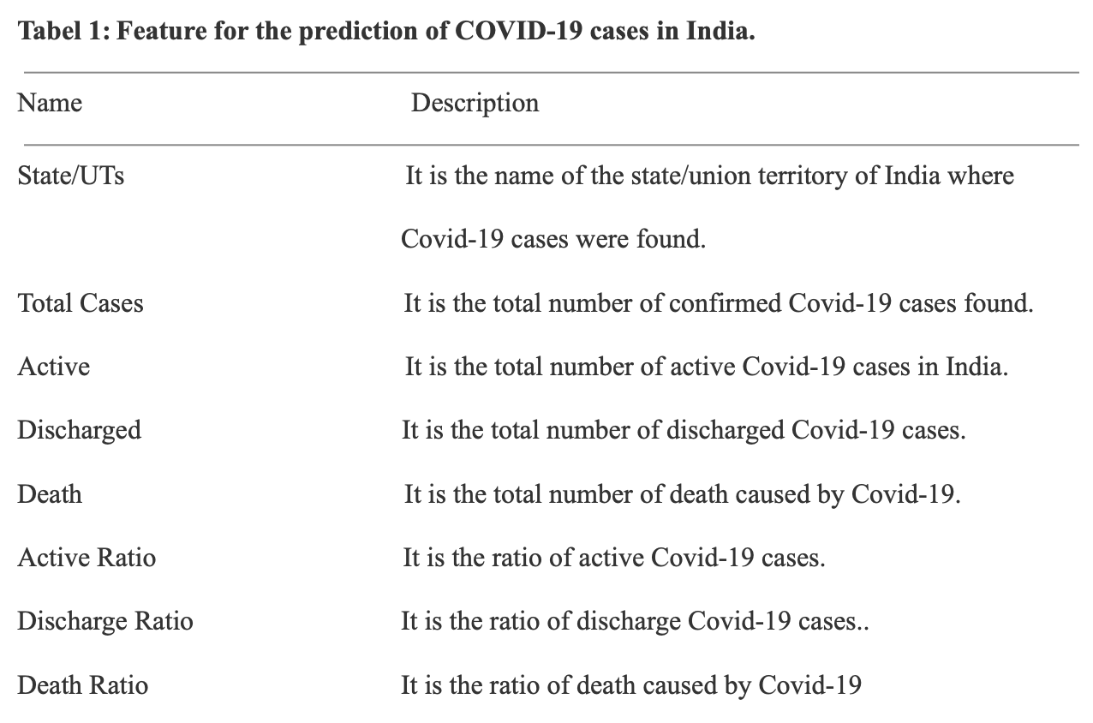
Methodology
Dataset and its features
Covid-19 India - https://www.kaggle.com
Table 1 shows the attributes/features used in this study and a glimpse of the dataset is presented in Table 2.

Slide 9
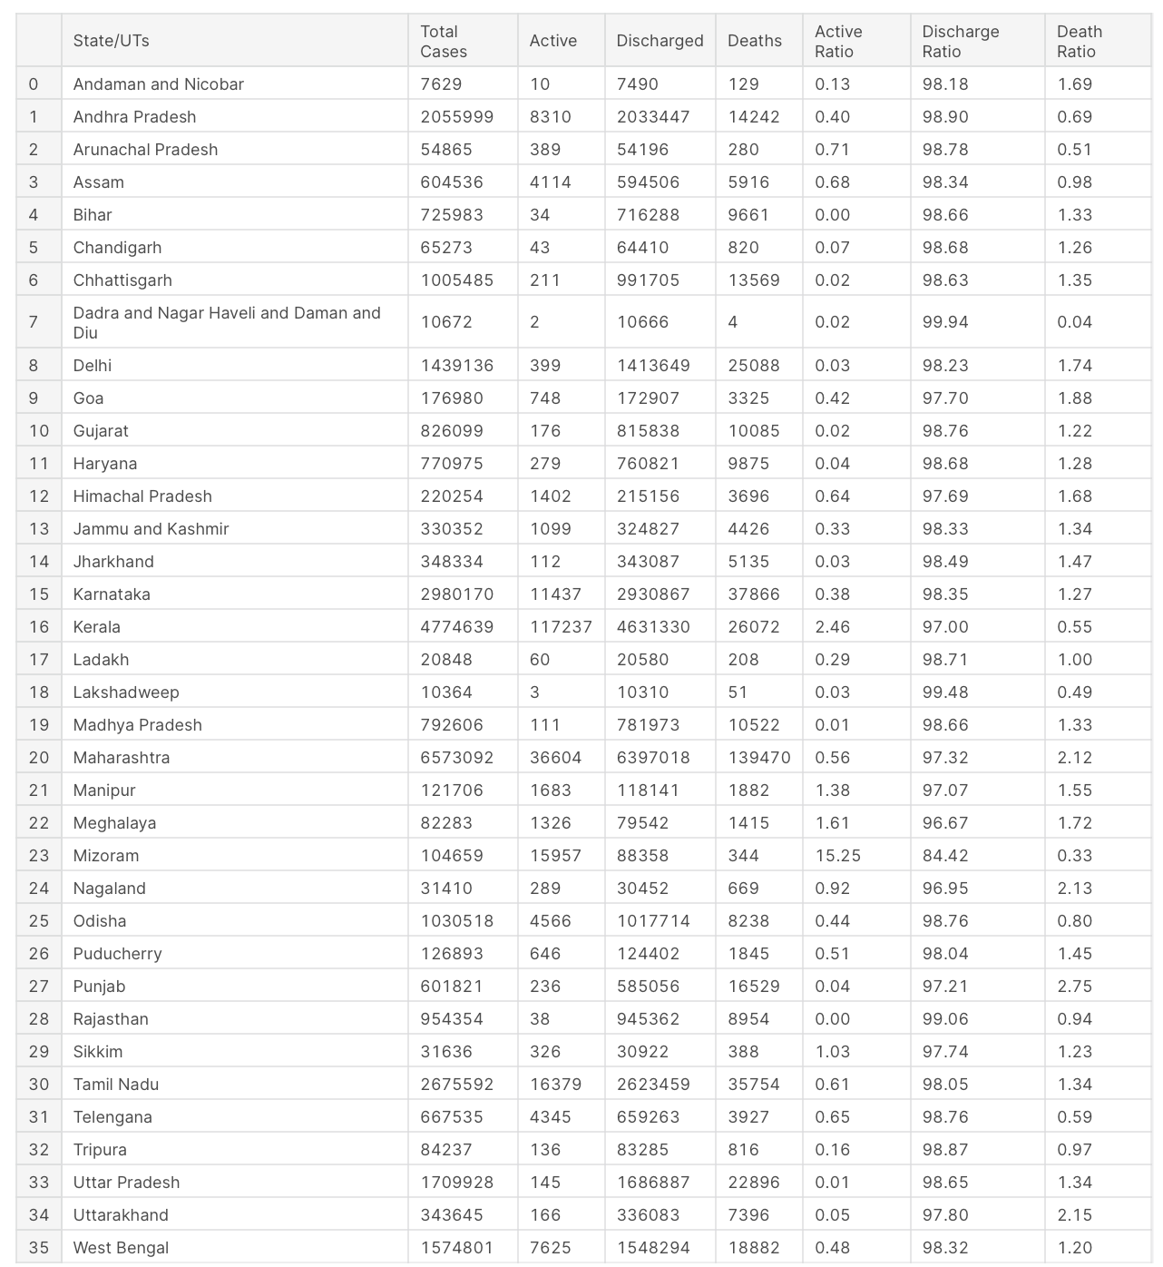

Slide 10
Feature selection
we performed feature selection using random forest importance algorithm in Python programming language.
It reduces the complexity of the prediction model.
The algorithm used:
Approach
The proposed approach is based on Linear Regression for the prediction for discharge ratio.
For the proposed Linear Regression approach Python programing is used, where some libraries of python was used such as sklearn and matplotlib.
A train and test were created.

Slide 11
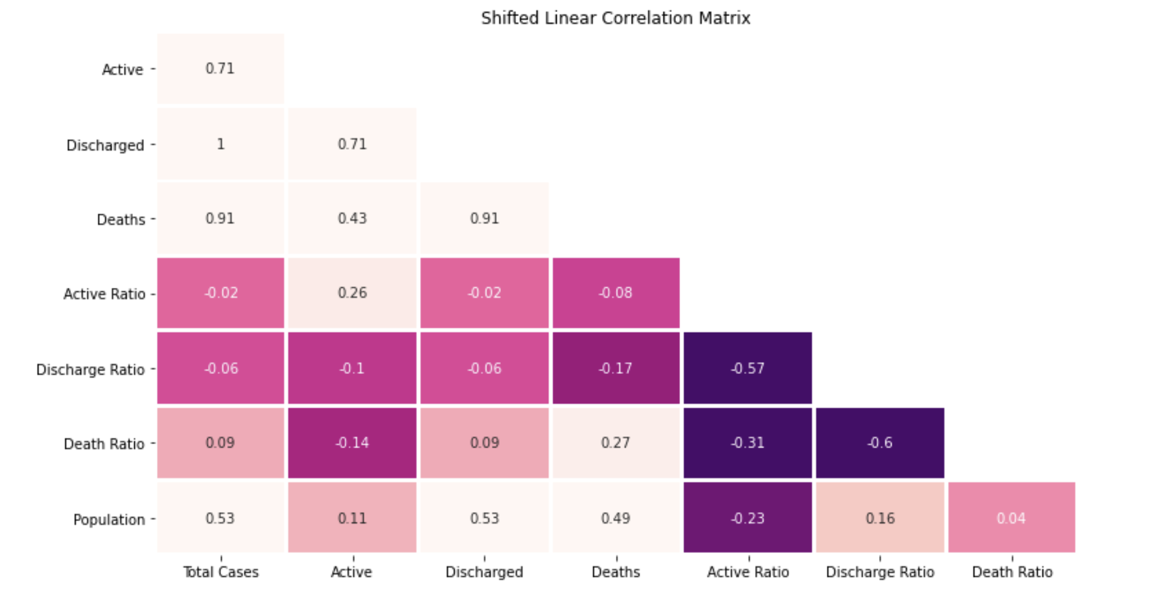
Correlation Matrix

Slide 12
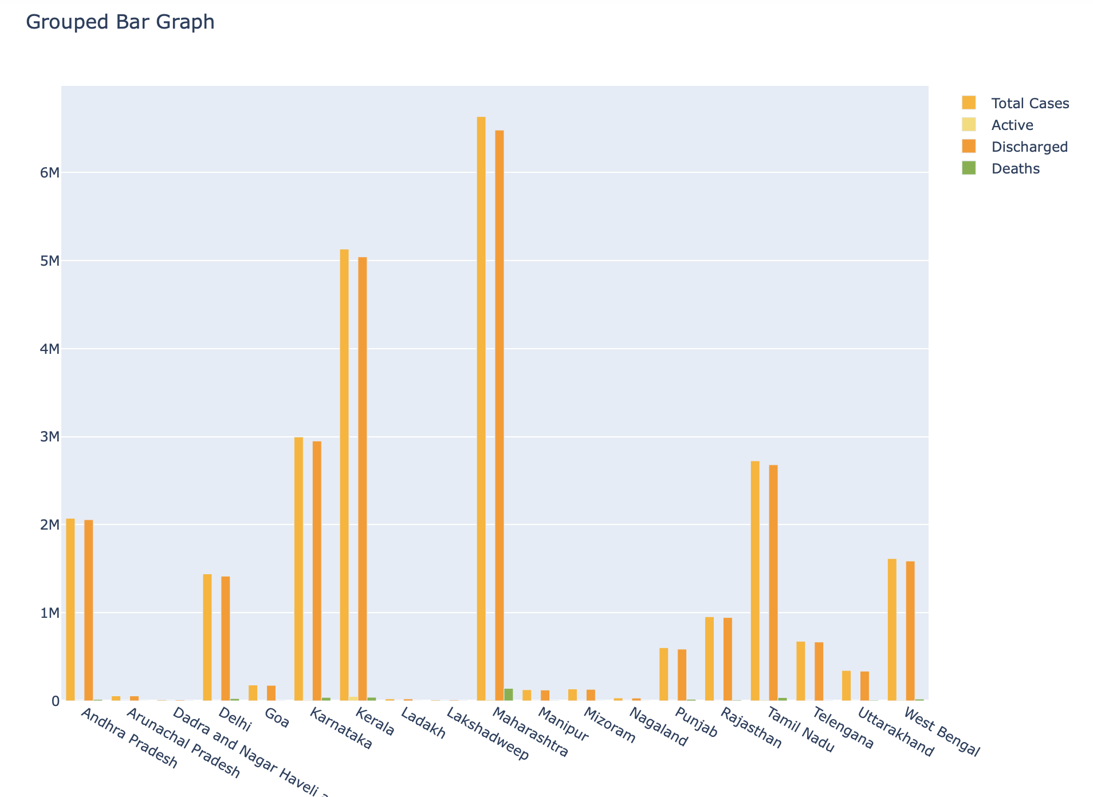
Visualization Of Features

Slide 13
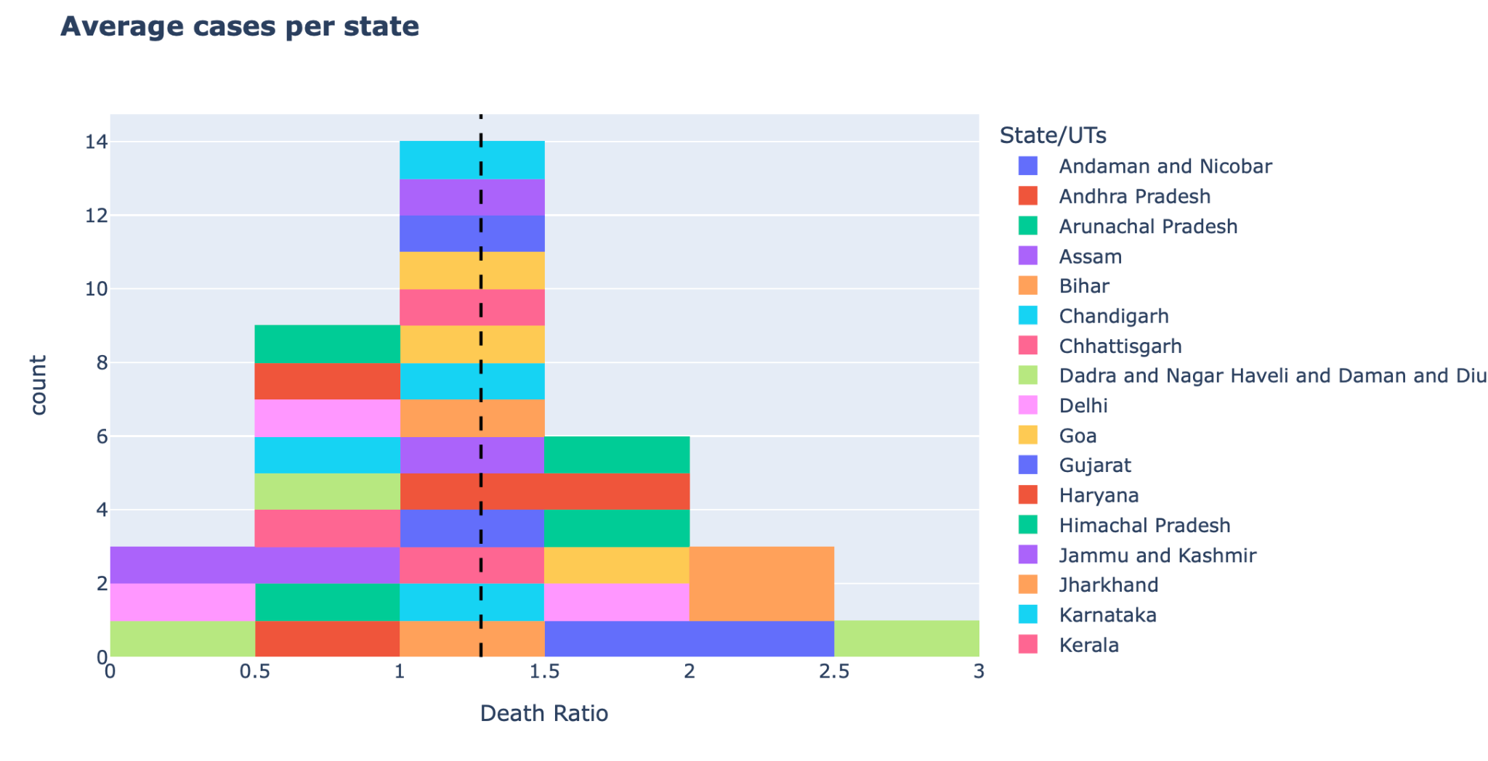

Slide 14
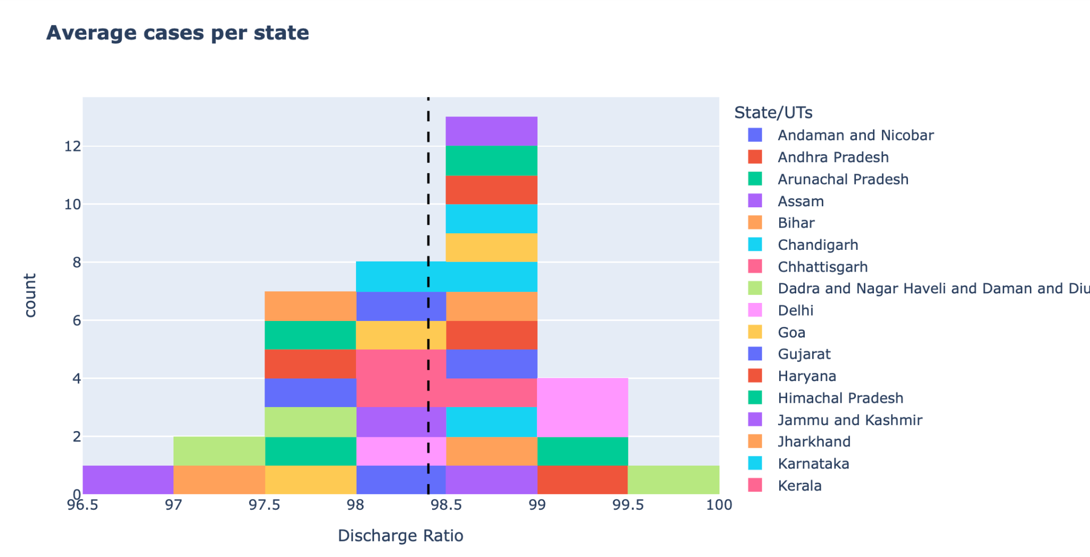

Slide 15
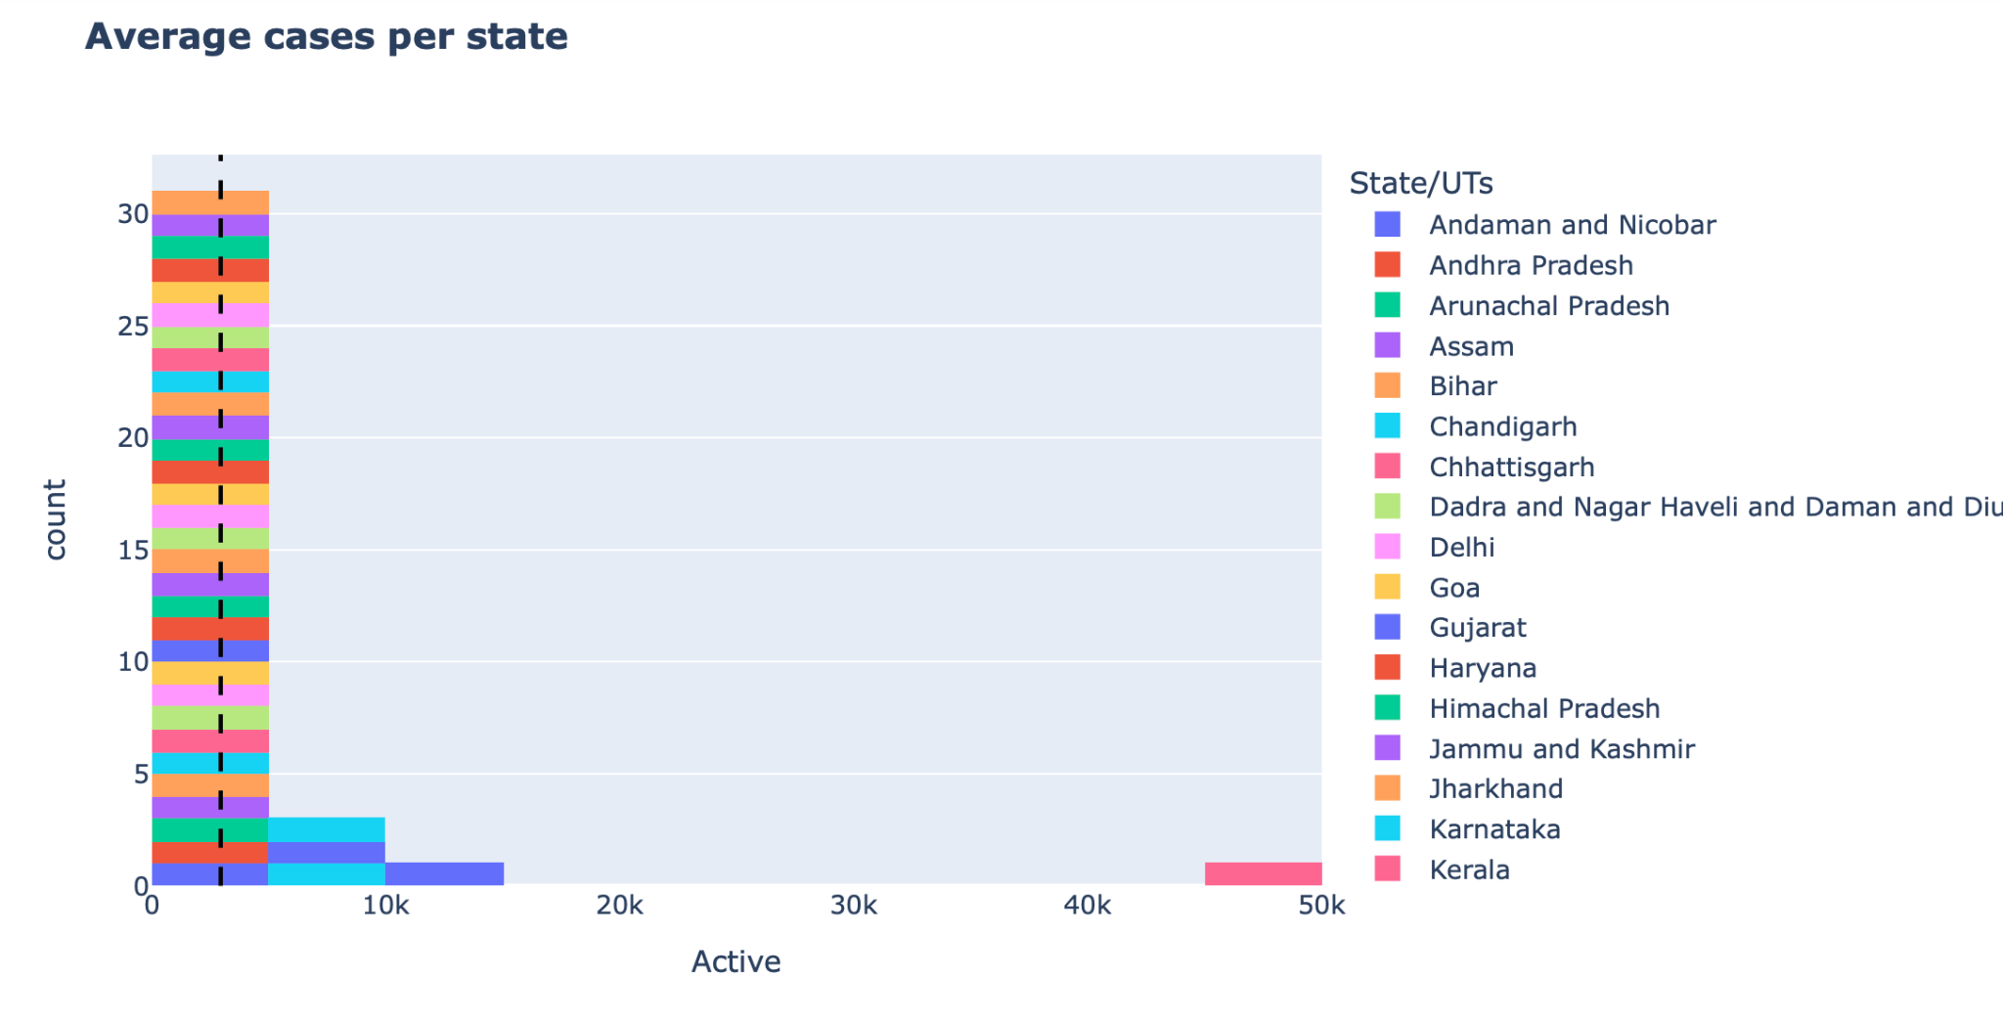

Slide 16
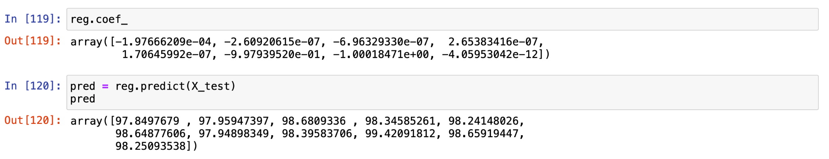
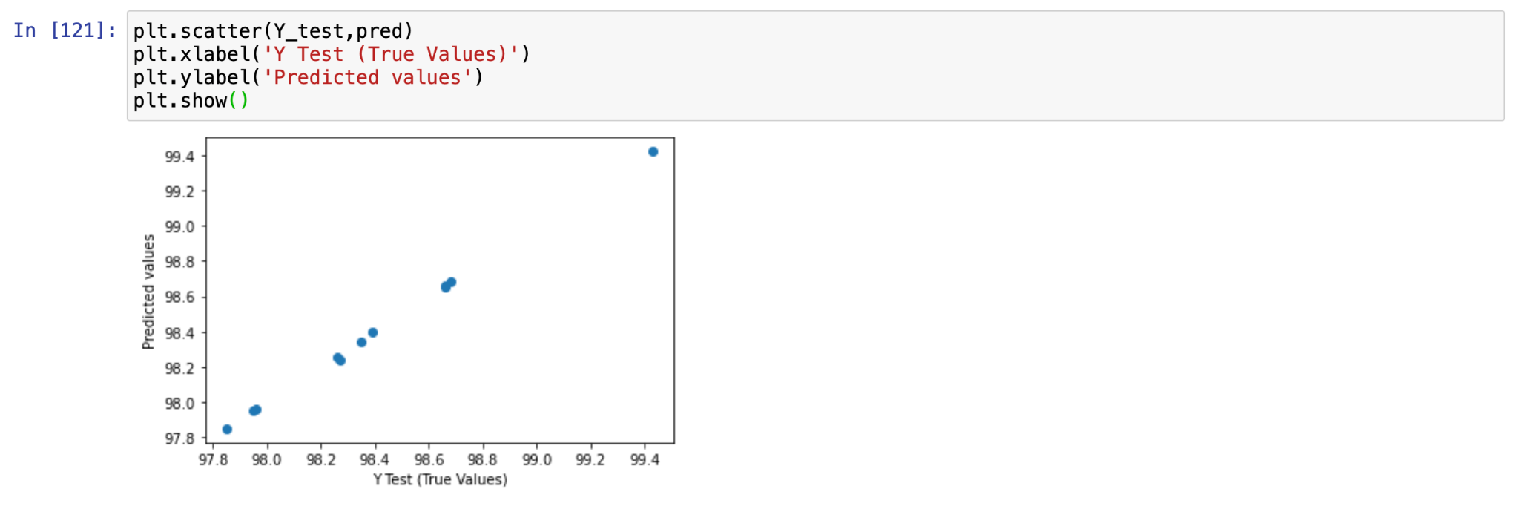
Result
Predicted correlation matrices
Predicted Linear Regression

Slide 17
Continued...
Predicted variance score
The predicted variance score was 0.99957.

Slide 18
CONCLUSION
This study discussed the spread of COVID-19 in different states of India and proposed a machine learning model for prediction of discharge ratio using linear regression.

Slide 19
FUTURE WORK
In terms of future scope, we can extend our work to predict the future risk from Covid-19 and to find more factors that can help us to fight this pandemic.To study the different variants of covid-19 virus, its measure and what precautions we can take.
The proposed model may be extended to predict the end of this pandemic in a particular region. Total causality and total economic losses may be predicted with the help of this model.
Multiple linear regression and autoregression will be used to predict the possible number of cases in the future.

Slide 20
REFERENCES
S. Ghosal, S. Sengupta, M. Majumder, and B. Sinha, Prediction of the number of deaths in India due to SARS- CoY-2 at 5-6 weeks, Diabetes & Metabolic Syndrome: Clinical Research & Reviews, vol. 14, no. 4, pp. 311-315,2020.
COVID-19 open research dataset challenge (CORD- 19), https://www.kaggle.com/allen-institute-for-ai/CORD- 19-research-challenge, 2020.
S. Tiwari, S. Kumar, and K. Guleria, Outbreak trends of coronavirus disease-2019 in India: A prediction, Disaster Medicine and Public Health Preparedness, doi: 10. 1017/dmp.2020. 115.
K. Sarkar, S. Khajanchi, and J. J. Nieto, Modeling and forecasting the COYID-19 pandemic in India, Chaos, Solitons & Fractals, vol. 139, p. 110049,2020.
S. Gupta, G. S. Raghuwanshi, and A. Chanda, Effect of weather on COVID-19 spread in the us: A prediction model for India in 2020, Science of the Total Environment, vol. 728, p. 138860, 2020.

Slide 21
Thank you
.

